Slide 1
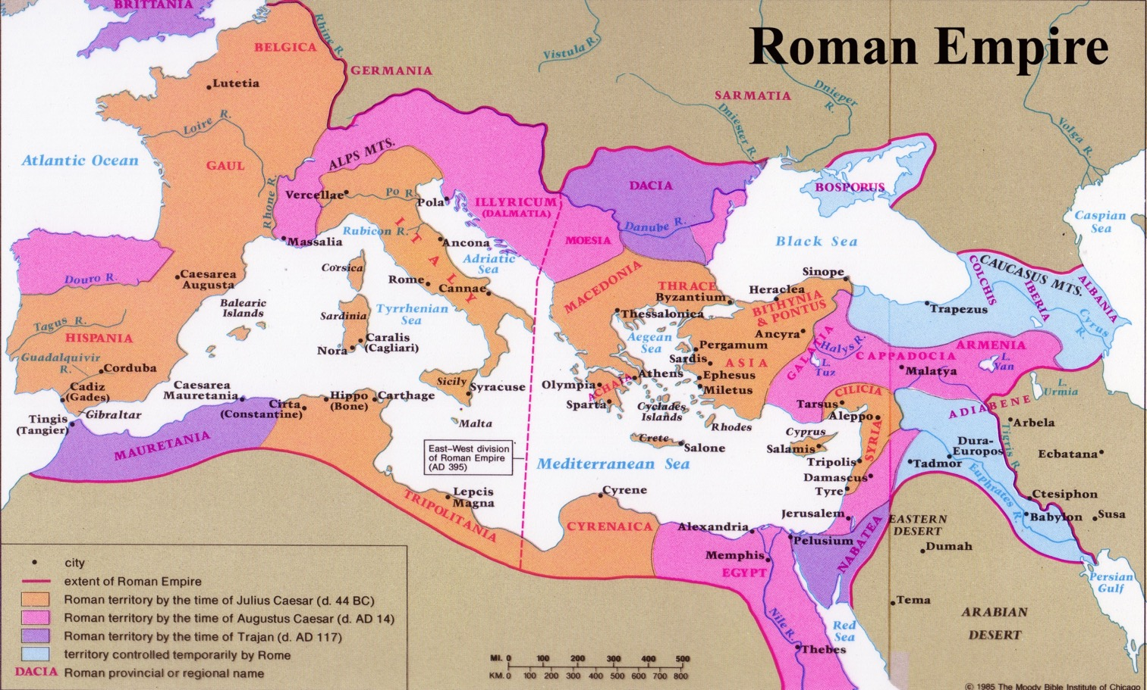
Lãnh Thổ La mã (50 BC-AD 100)
165
Đế Quốc La Mã
Tiến sĩ Rick Griffith • Trường Kinh Thánh Singapore • BibleStudyDownloads.org

Slide 2



Các Hoàng Đế
185
Hê-rốt
Đếquốc
Cá
C
V
U
a
Sovới.
Đế quốc La mã

Slide 3

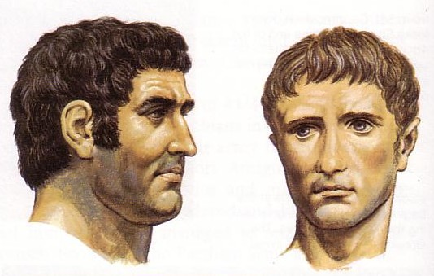
Các hoàng đế La mã
175

Slide 4
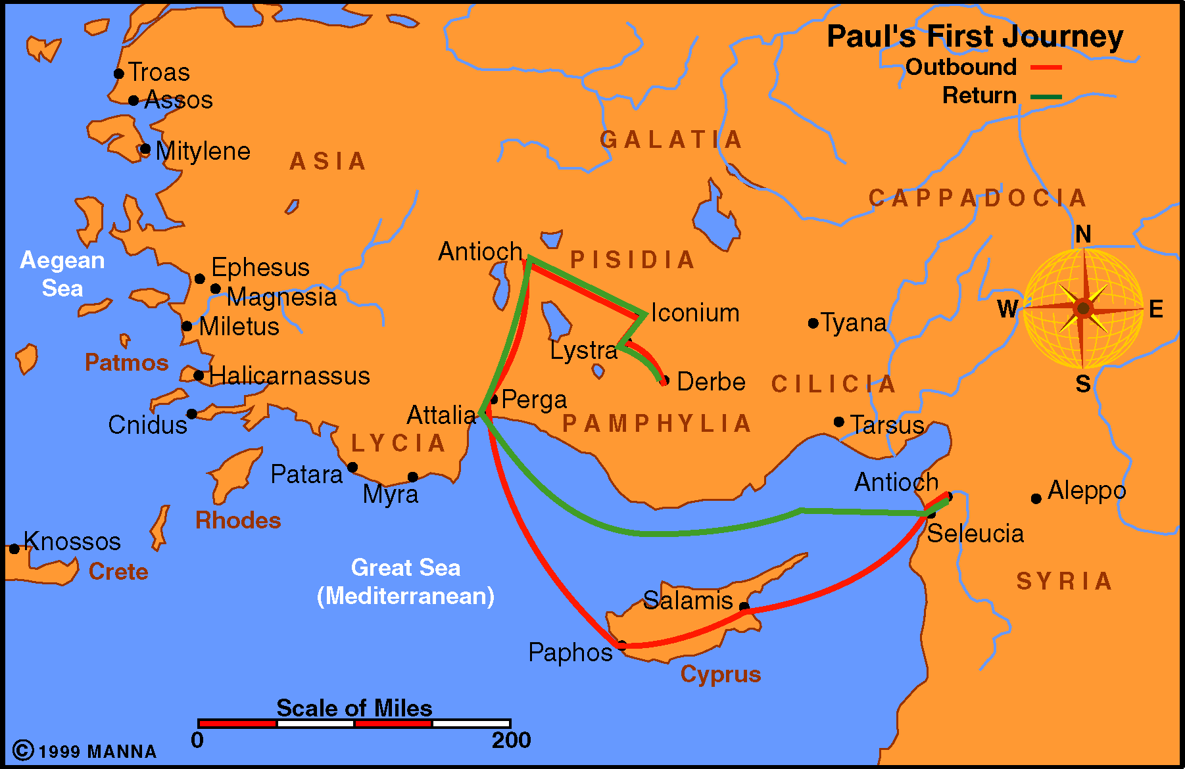
Paul Journey 1
166

Slide 5
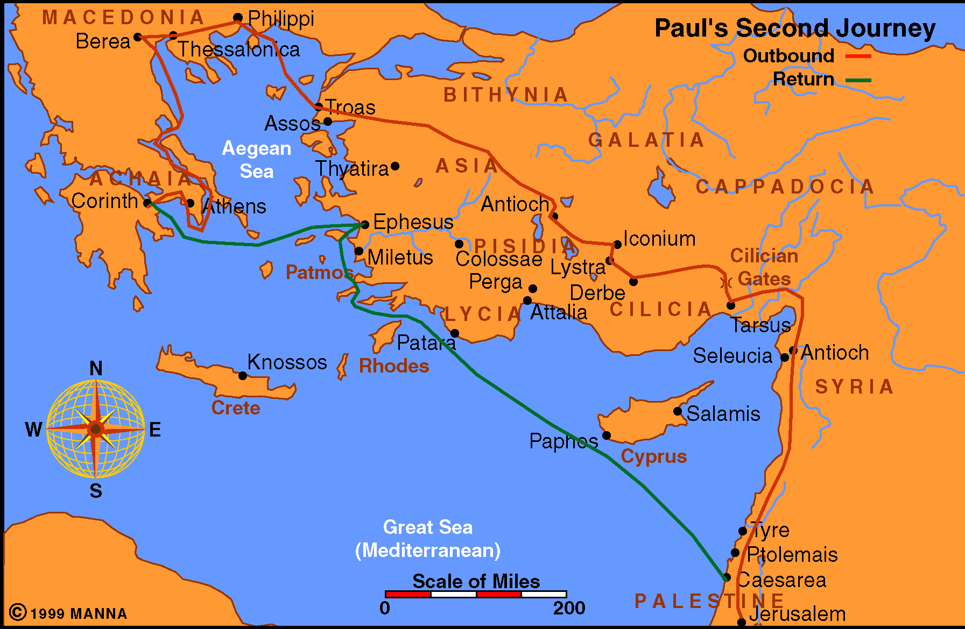
Paul Journey 2
166

Slide 6
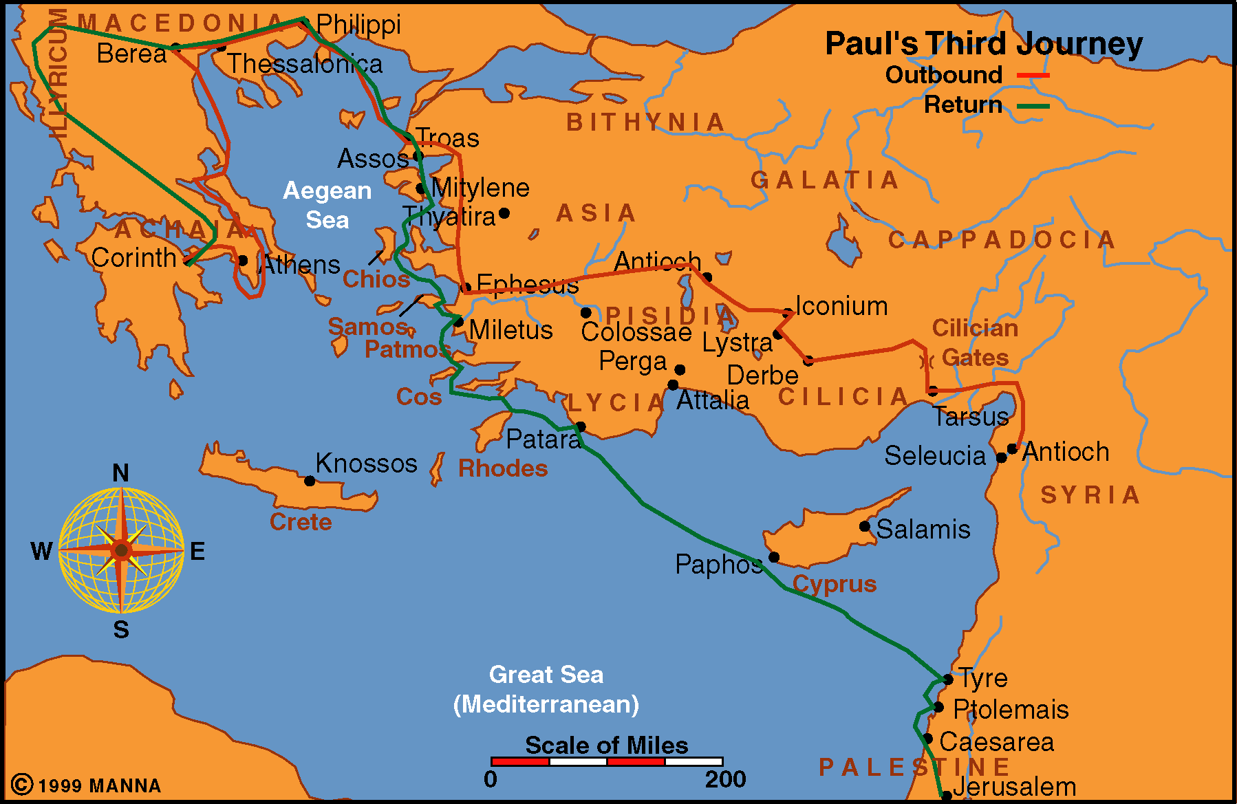
Paul Journey 3
167

Slide 7
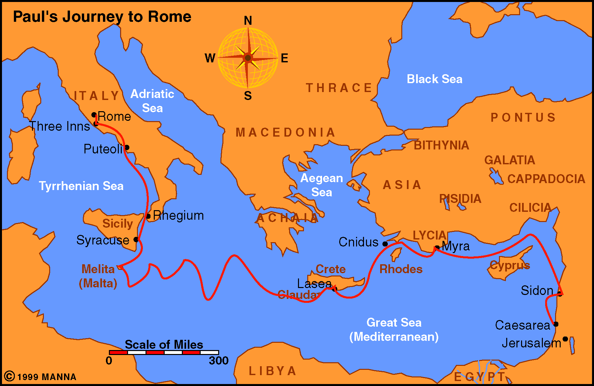
Paul Journey to Rome
167

Slide 8
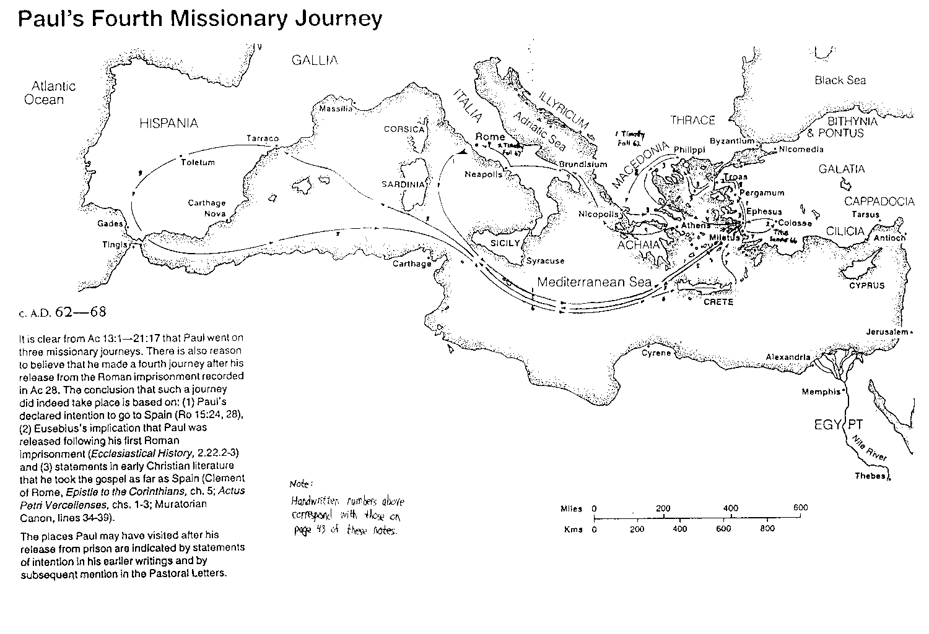
Chuyến hành trình Thứ Tư của Phao-lô
168

Slide 9
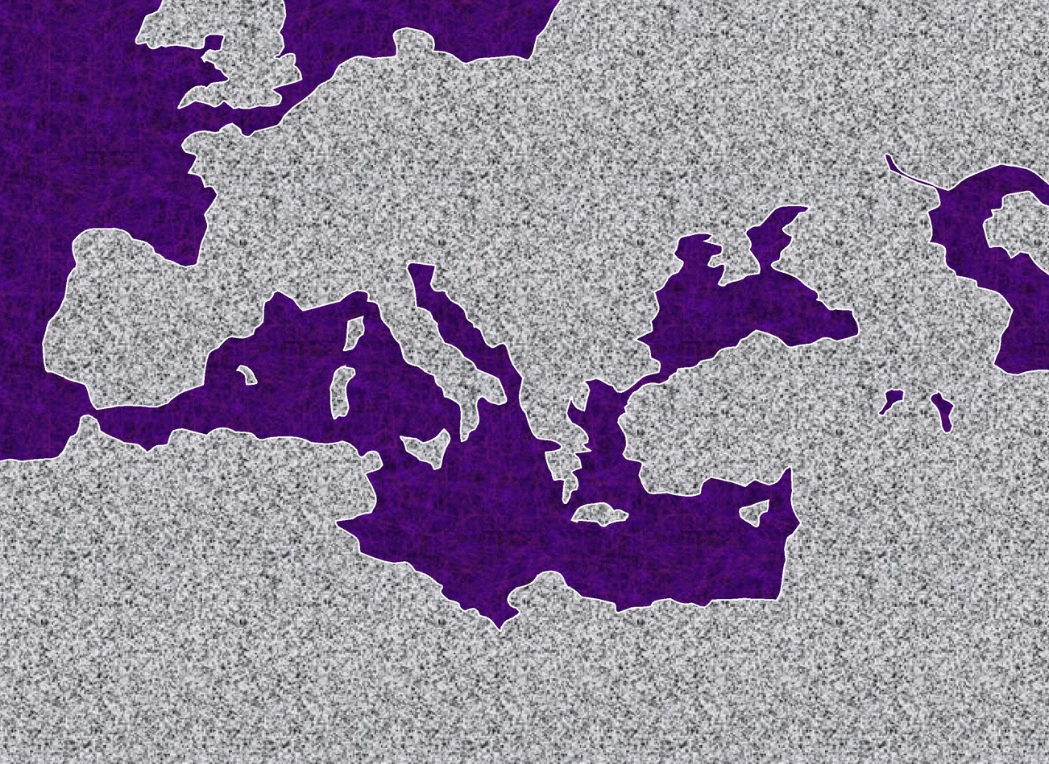

Roman Empire Extent
ATLANTIC OCEAN
Châu Âu
Đế quốc La Mã
ASIA
ROME•
•
Phi Châu
ISRAEL
MEDITERRANEAN SEA
ARAB
8.0.08.
© 2004 TBBMI
41

Slide 10
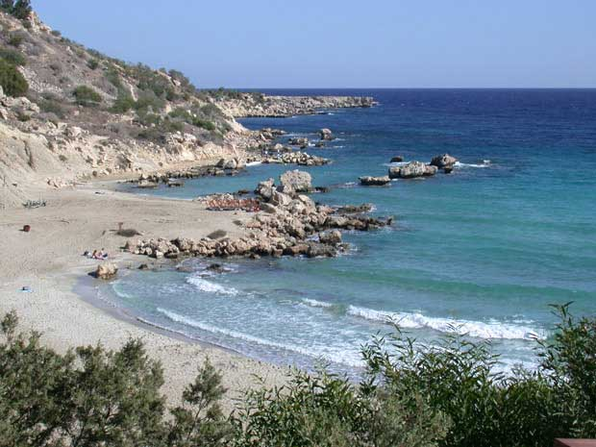
Journey 1
STUDY HELP #24
PAUL’S JOURNEYS …AT A GLANCE
ATLANTIC OCEAN
46-48 S.C.
EUROPE
Bãi biển tại CYPRUS
ASIA
ROME•
•Macedonia
•Pisidian Antioch
•
•Ephesus
AFRICA
Athens
Công vụ 13-14
•Syrian Antioch
MEDITERRANEAN SEA
#1.“The Hook: Một phòng thí nghiệm
•Jerusalem
Ý nghĩa: Được tôn thành thần; làm phép lạ; Phao-lô bị ném đá; công tác khó khăn; thành lập Hội Thánh; trở về bằng đường cũ.
ARABIA
8.0.08.
14
© 2004 TBBMI
42

Slide 11
Jerusalem Council
A.D.49
PAUL’S JOURNEYS …AT A GLANCE
Acts 15:1: Must a Gentile become a Jew, and accept his laws and ceremonies, before he can become a Christian?
ATLANTIC OCEAN
EUROPE
GRACE ONLY!
ASIA
ROME•
•Macedonia
•Pisidian Antioch
•
•Ephesus
AFRICA
Athens
Acts 15
•Syrian Antioch
MEDITERRANEAN SEA
1(--)2“The Jerusalem Council”
•Jerusalem
The issue was permanently settled: GRACE, not LAW!
ARABIA
8.0.08.
4
© 2004 TBBMI
43

Slide 12
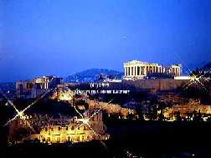
Journey 2
ATLANTIC OCEAN
A.D. 49-52
EUROPE
ASIA
ROME•
•Macedonia
•Pisidian Antioch
•
•Ephesus
AFRICA
Athens
Acts 15-18
•Syrian Antioch
MEDITERRANEAN SEA
2. “The European Thrust”
•Jerusalem
Significance: many church plantings; call to Macedonia,on to Athens, the “unknown god”; Mars Hill; lengthy Corinthian stay.
ARABIA
8.0.08.
5
8.0.08.
©2004 TBBMI
44
© 2004 TBBMI

Slide 13
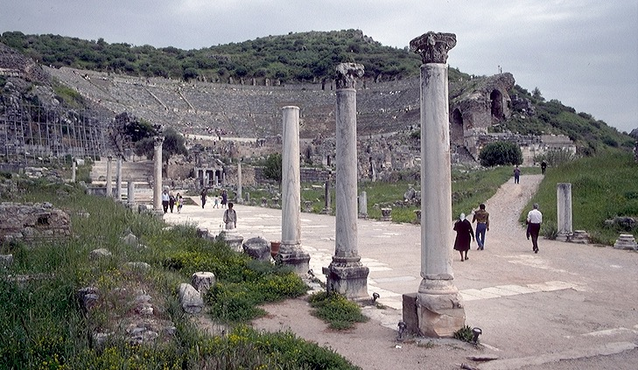
Journey 3
ATLANTIC OCEAN
A.D. 53-57
EUROPE
ANCIENT EPHESUS
ASIA
ROME•
•Macedonia
•Pisidian Antioch
•
•Ephesus
AFRICA
Athens
Acts 18-21
•Syrian Antioch
MEDITERRANEAN SEA
3.“The Asian Thrust”
•Jerusalem
Significance: extended time at the church in Ephesus; young man raised from the dead; important letters written; riot with Ephesian artisans at amphitheatre.
ARABIA
8.0.08.
4
45
© 2004 TBBMI
8.0.08.

Slide 14
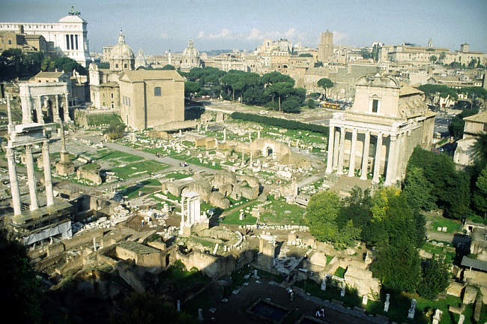
Journey 4
A.D. 59-62
STUDY HELP # 36
ATLANTIC OCEAN
EUROPE
ASIA
ROME•
ROME’S ANCIENT FORUM
•Macedonia
•Pisidian Antioch
•
•Ephesus
AFRICA
Athens
Acts 21-28
•Syrian Antioch
MEDITERRANEAN SEA
4. “To Rome and GAIN!”
•Jerusalem
ARABIA
Significance: As a prisoner, sent to Rome; Christian influence in prison and the house of Caesar; important later letters; “fought the good fight, kept the faith!”
8.0.08.
3
8.0.08.
© 2004 TBBMI
46

Slide 15


Journey Summary
STUDY HELP #36
#1 THE HOOK: A LABORATORY
AT A GLANCE: PAUL’S MISSIONARY JOURNEYS
ATLANTIC OCEAN
EUROPE
(21 Books)
INTERIM: JERUSALEM COUNCIL
ASIA
CHURCH
ISSUES
•Macedonia
#2: THE EUROPEAN THRUST
•Pisidian Antioch
•
•Ephesus
AFRICA
Athens
The Epistles
•Syrian Antioch
MEDITERRANEAN SEA
•Jerusalem
#3: THE ASIAN THRUST
ARABIA
#4: TO ROME AND GAIN
8.0.08.
7
47

Slide 16
The NT Comes Together
(21 Books)
CHURCH
ISSUES
THE EPISTLES: Letters from Paul
Dates of Writing:
A.D. 50s - 90s
THE EPISTLES
Concerning generally unexplored issues requiring new and crucial instruction in leadership of the new organism...
the ECCLESIA,
the CHURCH.
Most letters from Paul …fewer letters from “The Others.”
Letters from
The Others
Letters from
The Others
48
3

Slide 17
The Spread of the Early Church
(21 Books)
CHURCH
ISSUES
THE EPISTLES: Letters from Paul
Dates of Writing:
A.D. 50s - 90s
THE EPISTLES
Concerning generally unexplored issues requiring new and crucial instruction in leadership of the new organism...
the ECCLESIA,
the CHURCH.
Most letters from Paul …some fewer from “The Others.”
Letters from
The Others
Letters from
The Others
HỘI THÁNH ĐẦU TIÊN PHÁT TRIỂN
REPRESENTATIONAL LOCATIONS ONLY
8.0.08.
©2004 TBBMI
49

Slide 18
Where were they written?
Rôma
EPHÊSÔ
MACEDONIA
COLOSE
PHILEMON
II CÔ-RINH-TÔ
PHILIP
1 TIMÔTHÊ..
Ê-PHÊ-SÔ
HÊ-BƠ-RƠ?
1 PHI
CÔ-RINH-TÔ
2 PHI
1 CORINTÔ
ANTIỐT xứ SYRI
ROMA
2 TIMOTHÊ.
1 TE
TIT
2 TE..
1 Gi
2 GI
GALATI..
Được viết tại đâu?
3 Gi..
JERUSALEM
GIA-CƠ
GIU-ĐE..
8.0.08.
27
©2004 TBBMI
67

Slide 19
The circular letters… keeping in touch
ROME
EPHESIANS
MACEDONIA
COLOSSIANS
PHILEMON
2 CORINTHIANS
PHILIPPIANS
1 TIMOTHY..
EPHESUS
HEBREWS?
1 PETER
CORINTH
2 PETER
1 CORINTHIANS
SYRIAN ANTIOCH
ROMANS
2 TIMOTHY..
1 THESS
TITUS
Thư tín lan truyền… để biết tin tức
2 THESS..
1 JOHN
2 JOHN
GALATIANS..
3 JOHN..
JERUSALEM
JAMES
JUDE..
8.0.08.
©2004 TBBMI
68

Slide 20
Black

Slide 21


Bối cảnh thời Cựu Ước—BibleStudyDownloads.org
Tải Về Tài Liệu Nghiên Cứu Kinh Thánh
Notes:
OT Backgrounds VN

